Slide 1
Capstone Design Proposal Presentation

Slide 2
Hello!
We are “LAJI”
-Jisu An
-Hyunjae Lee
-Jinwoo Jeon

Slide 3
Meet the Team
1
ㅇ
AN JISU
LEE HYUNJAE
JEON JINWOO
Jane Doe
Jane Doe
Jane Doe
BACKEND DEVELOPER
backend developer
FRONTEND DEVELOPER
Server management, Server-side development
Database, Server-side development
Highlight algorithm, Dashboard UI
ajs7270@gmail.com
leehj8687@email.com
zinuzian@gmail.com
Notes:
© Copyright Showeet.com – Creative & Free PowerPoint Templates

Slide 4
Contents
Project overview
Feedback reviews
4th week’s progress
Additional works
Schedule
Q&A

Slide 5
Project overview
What needs do we have?

Slide 6
Feedback reviews
What needs do we have?

Slide 7
4th week’s progress
User Interface
Database construction
Login with Google

Slide 8
4th week’s progress
User Interface

Slide 9
4th week’s progress
Database construction

Slide 10
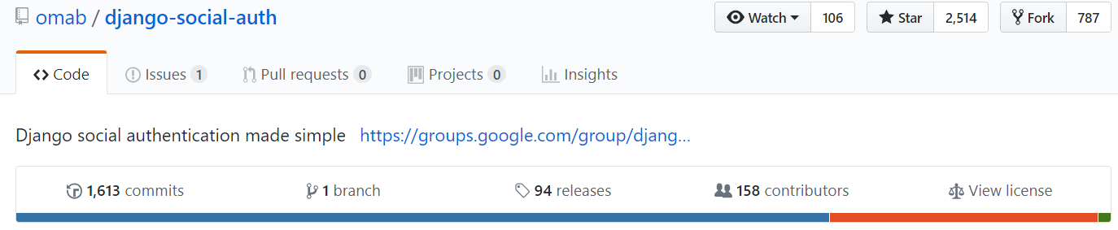
4th week’s progress
Login with Google
We used this, more precisely ‘social-auth-app-django'
Reference : https://python-social-auth.readthedocs.io/en/latest/configuration/django.html

Slide 11
Additional works
How do we get videos?
How do we get chats from videos?

Slide 12
Additional works
How do we get videos?

Slide 13
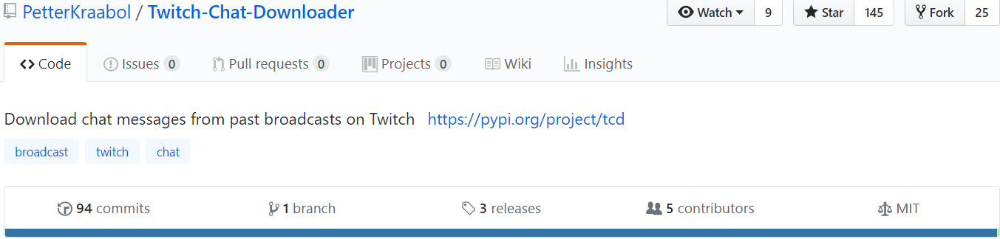
Additional works
How do we get chats from videos?
We used this,
But this is ‘executable file.’
So we have to figure out the way we can use this for our Django project

Slide 14
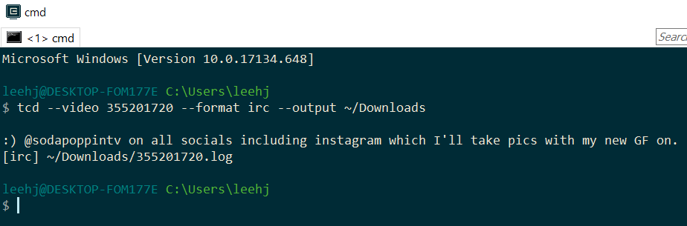
Additional works
How do we get chats from videos?
1.Video id
2.Title
3.Output

Slide 15
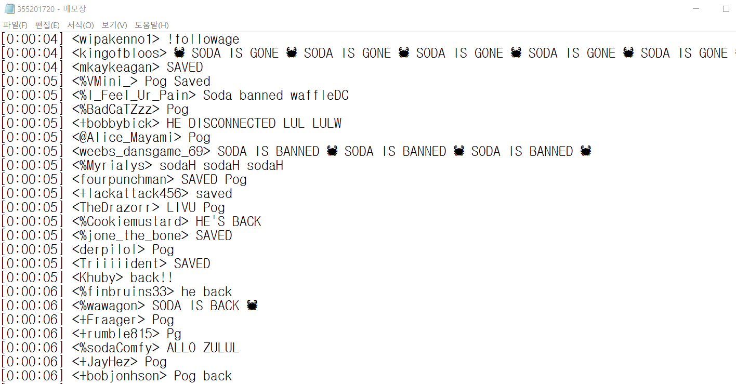
Additional works
How do we get chats from videos?
We will analyze this chats for our highlights.

Slide 16
Development plans
Week | Plan
1st | Idea & Proposal
2nd | Idea & Proposal
3rd | Server construction (Configuration setup : Nginx, domain(bind9), https), Test videos (Twitch/Game/Eng)
4th | Login (SNS), Database construction, Dashboard UI
5th | Video upload & download, Twitch chat API analyze
6th | Frame resizing, Designing highlight algorithm
7th | Demo

Slide 17
Development plans
8th | Highlight video analyze algorithm development and test
9th | Highlight video analyze algorithm development and test
10th | Highlight video analyze algorithm development and test
11st | Toss (payment), Test
12nd | Notification mail, Server test
13rd | Preparing for Final demo
14th | Final demo
15th | Final report

Slide 18
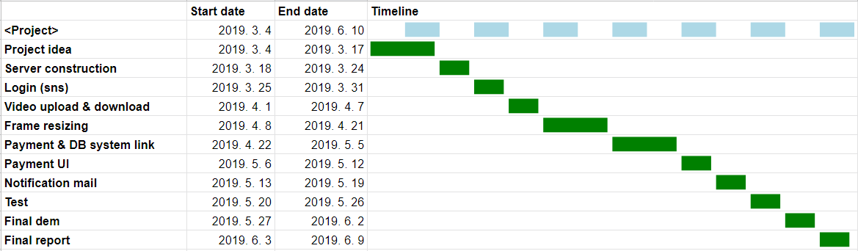
Development plans
Jisu An,

Slide 19
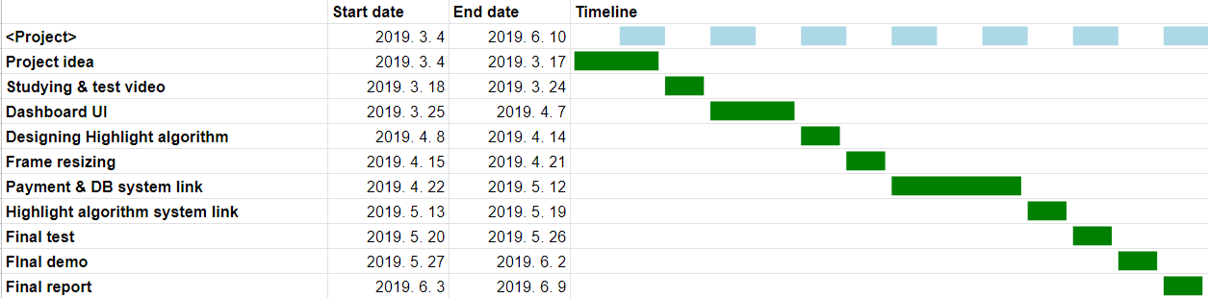
Development plans
Hyunjae Lee,

Slide 20
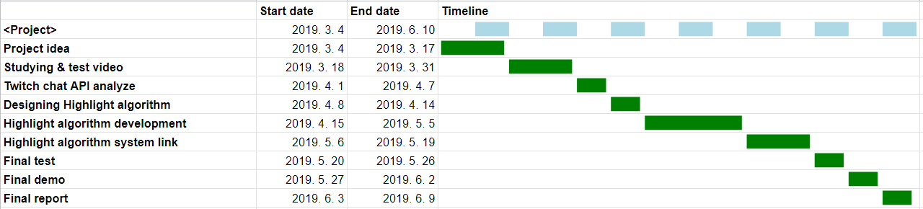
Development plans
Jinwoo Jeon,

Slide 21
Thank you!

Slide 22
USER
:ID(PK)
:name
:email(PK)
VIDEO
:ID(PK)
:title
:length
:url
:dir
:resizing(null)
:
CHAT
:ID(PK)
:title
Highlight
:ID(PK)
:title
:length
:url

